Slide 1
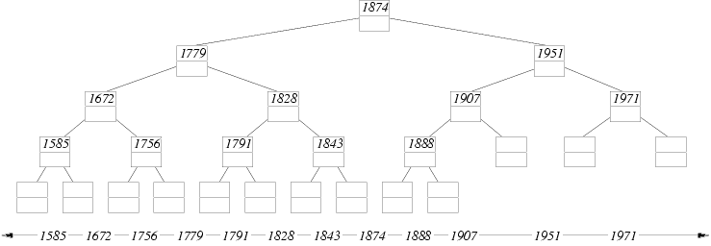


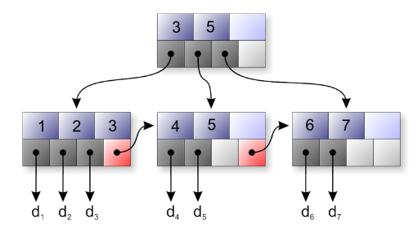

Data Structures Efficiency
Computational Complexity of Fundamental Data Structures, Choosing a Data Structure

Slide 2

Table of Contents
Fundamental Data Structures – Comparison
Arrays
Lists
Trees
Hash-Tables
Sets
Bags
Choosing Proper Data Structure

Slide 3

Comparing Data Structures
Time Complexity of Basic Operations

Slide 4
Data Structures Efficiency
Data Structure | Add | Find | Delete | Get-by-index
Array (T[]) | O(n) | O(n) | O(n) | O(1)
Linked list (LinkedList<T>) | O(1) | O(n) | O(n) | O(n)
Resizable array list (List<T>) | O(1) | O(n) | O(n) | O(1)
Stack (Stack<T>) | O(1) | - | O(1) | -
Queue (Queue<T>) | O(1) | - | O(1) | -

Slide 5
Data Structures Efficiency (2)
Data Structure | Add | Find | Delete | Get-by-index
Hash table (Dictionary<K,T>) | O(1) | O(1) | O(1) | -
Tree-based dictionary (Sorted Dictionary<K,T>) | O(log n) | O(log n) | O(log n) | -
Hash table based set (HashSet<T>) | O(1) | O(1) | O(1) | -
Tree based set (SortedSet<T>) | O(log n) | O(log n) | O(log n) | -

Slide 6
Choosing Data Structure
Arrays (T[])
Use when fixed number of elements should be processed by index
Resizable array lists (List<T>)
Use when elements should be added and processed by index
Linked lists (LinkedList<T>)
Use when elements should be added at the both sides of the list
Otherwise use resizable array list (List<T>)

Slide 7
Choosing Data Structure (2)
Stacks (Stack<T>)
Use to implement LIFO (last-in-first-out) behavior
List<T> could also work well
Queues (Queue<T>)
Use to implement FIFO (first-in-first-out) behavior
LinkedList<T> could also work well
Hash table based dictionary (Dictionary<K,T>)
Use when key-value pairs should be added fast and searched fast by key
Elements in a hash table have no particular order

Slide 8
Choosing Data Structure (3)
Balanced search tree based dictionary (SortedDictionary<K,T>)
Use when key-value pairs should be added fast, searched fast by key and enumerated sorted by key
Hash table based set (HashSet<T>)
Use to keep a group of unique values, to add and check belonging to the set fast
Elements are in no particular order
Search tree based set (SortedSet<T>)
Use to keep a group of ordered unique values

Slide 9
Summary
Algorithm complexity is rough estimation of the number of steps performed by given computation
Complexity can be logarithmic, linear, n log n, square, cubic, exponential, etc.
Allows to estimating the speed of given code before its execution
Different data structures have different efficiency on different operations
The fastest add / find / delete structure is the hash table – O(1) for all these operations

Slide 10

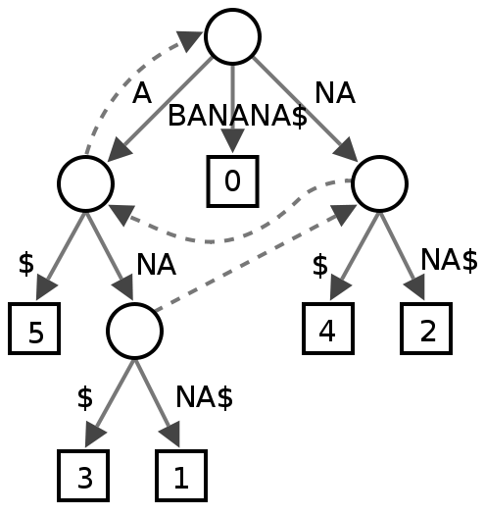
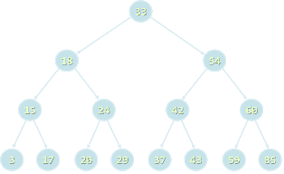
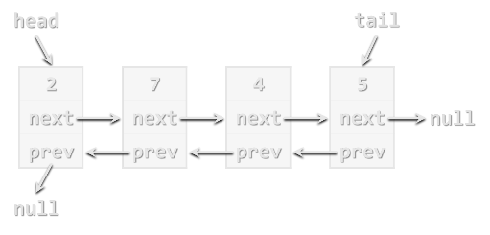

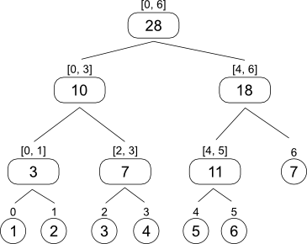
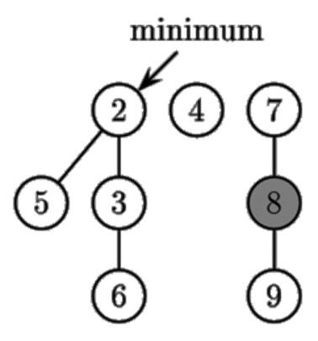
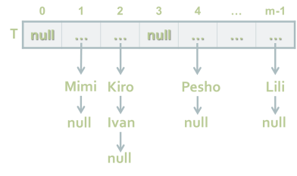
Data Structures Efficiency
http://academy.telerik.com

Slide 11
Exercises
A text file students.txt holds information about students and their courses in the following format:
Using SortedDictionary<K,T> print the courses in alphabetical order and for each of them prints the students ordered by family and then by name:
Kiril | Ivanov | C#
Stefka | Nikolova | SQL
Stela | Mineva | Java
Milena | Petrova | C#
Ivan | Grigorov | C#
Ivan | Kolev | SQL
C#: Ivan Grigorov, Kiril Ivanov, Milena Petrova
Java: Stela Mineva
SQL: Ivan Kolev, Stefka Nikolova

Slide 12
Exercises (2)
A large trade company has millions of articles, each described by barcode, vendor, title and price. Implement a data structure to store them that allows fast retrieval of all articles in given price range [x…y]. Hint: use OrderedMultiDictionary<K,T> from Wintellect's Power Collections for .NET.
Implement a class BiDictionary<K1,K2,T> that allows adding triples {key1, key2, value} and fast search by key1, key2 or by both key1 and key2. Note: multiple values can be stored for given key.

Slide 13




Free Trainings @ Telerik Academy
C# Programming @ Telerik Academy
csharpfundamentals.telerik.com
Telerik Software Academy
academy.telerik.com
Telerik Academy @ Facebook
facebook.com/TelerikAcademy
Telerik Software Academy Forums
forums.academy.telerik.com

